Slide 1


Apache Spark
INCEPTEZ TECHNOLOGIES

Slide 2
Spark EXECUTION MODEL
INCEPTEZ TECHNOLOGIES

Slide 3
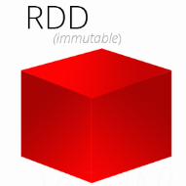
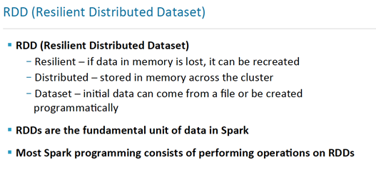
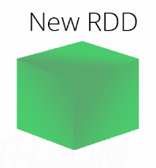
Pillars of Spark

Slide 4
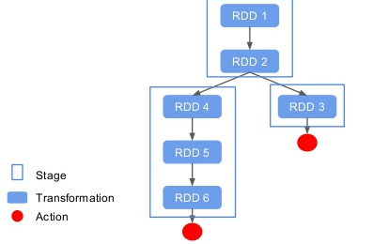
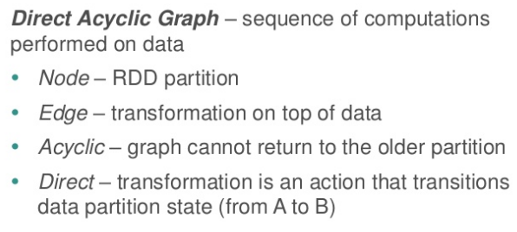
Pillars of Spark
INCEPTEZ TECHNOLOGIES

Slide 5
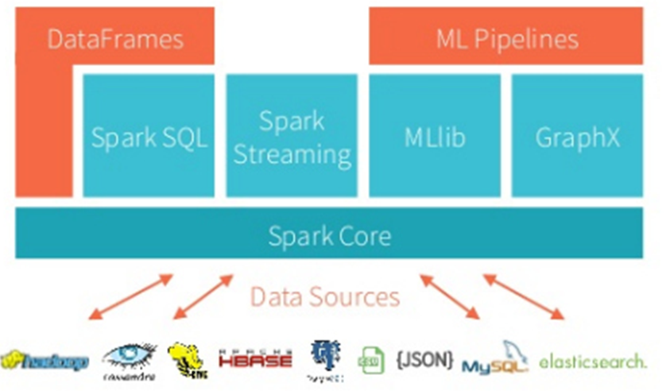
Spark Library Stack

Slide 6
Working with RDDs
INCEPTEZ TECHNOLOGIES

Slide 7
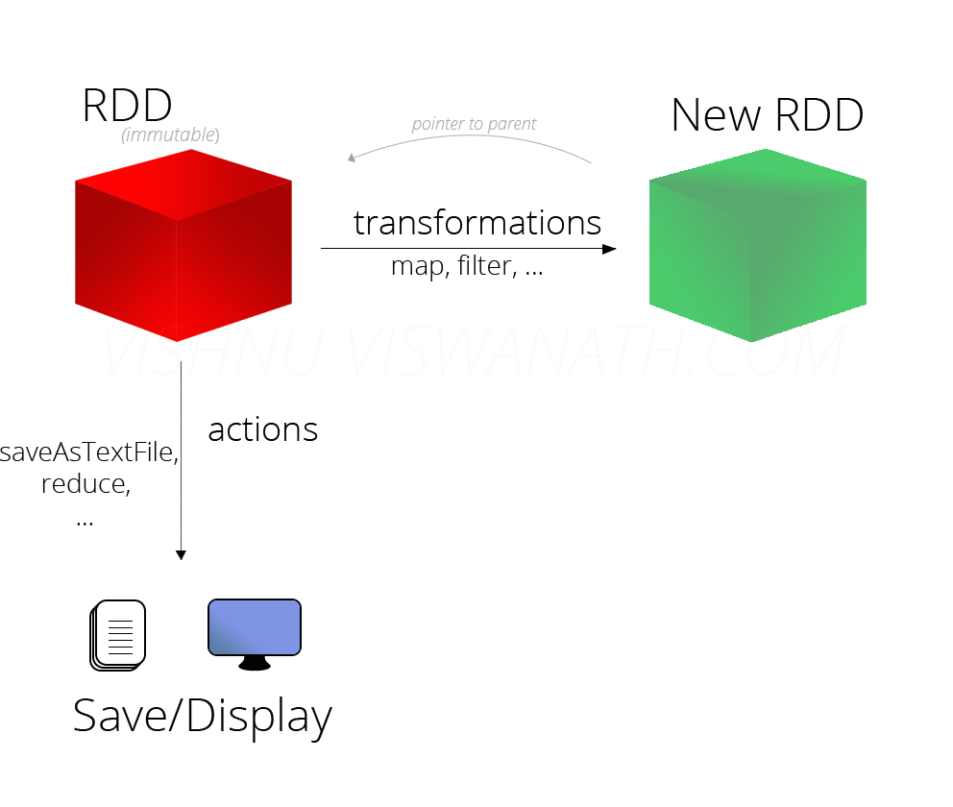
All about RDDs
Core Spark abstraction
Lazily evaluated
Partitions can be persisted in-memory or on-disk
Broken up into partitions, which are distributed across nodes
Abstraction to represent the large distributes
Immutable, re-computable
Fault tolerant – Via concept of Lineage
Contains transformation history (“lineage”) for data set
Metadata Stored for Interface
Partitions – Set of data splits associated with this RDD
Dependencies – List of parent RDDs involved in computation
Compute – Function to compute partitions
Preferred Locations – Place to put data
Partitioner – How the data is split into partitions
INCEPTEZ TECHNOLOGIES

Slide 8
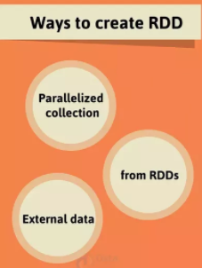
Creating RDDs Types of RDDs
Three ways to create an RDD
From a file or set of files
From Parallelized Collection
From another RDD
HadoopRDD
FilteredRDD
MappedRDD
PairRDD
ShuffledRDD
UnionRDD
JsonRDD
SchemaRDD
CassandraRDD
EsSparkRDD
INCEPTEZ TECHNOLOGIES

Slide 9
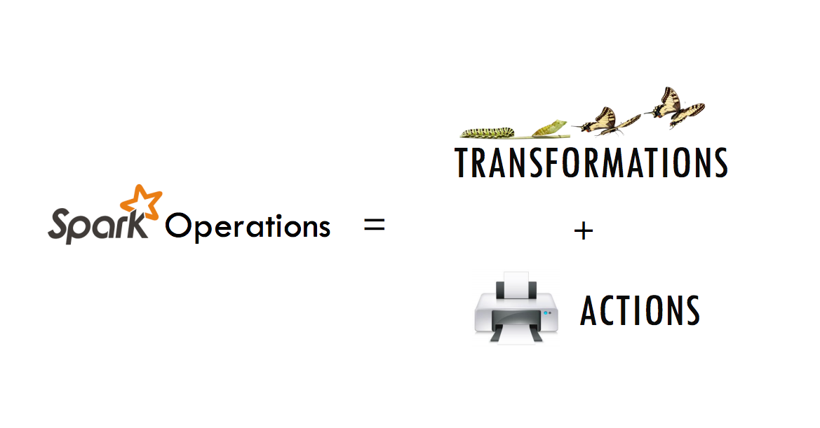
INCEPTEZ TECHNOLOGIES

Slide 10
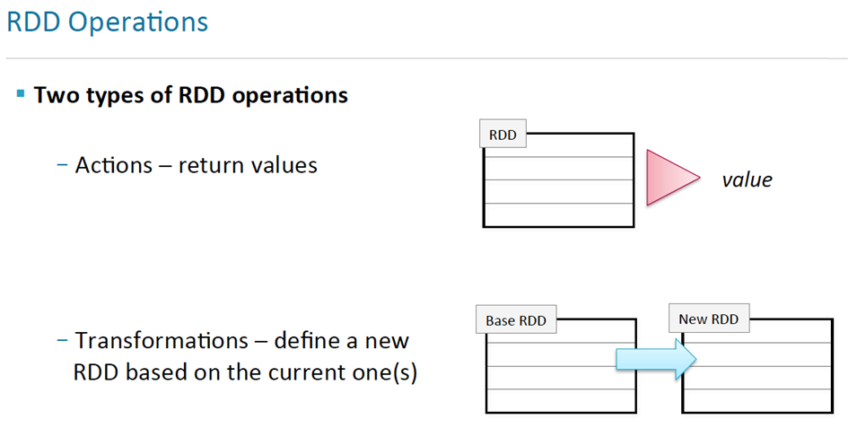
RDD Operations
INCEPTEZ TECHNOLOGIES

Slide 11
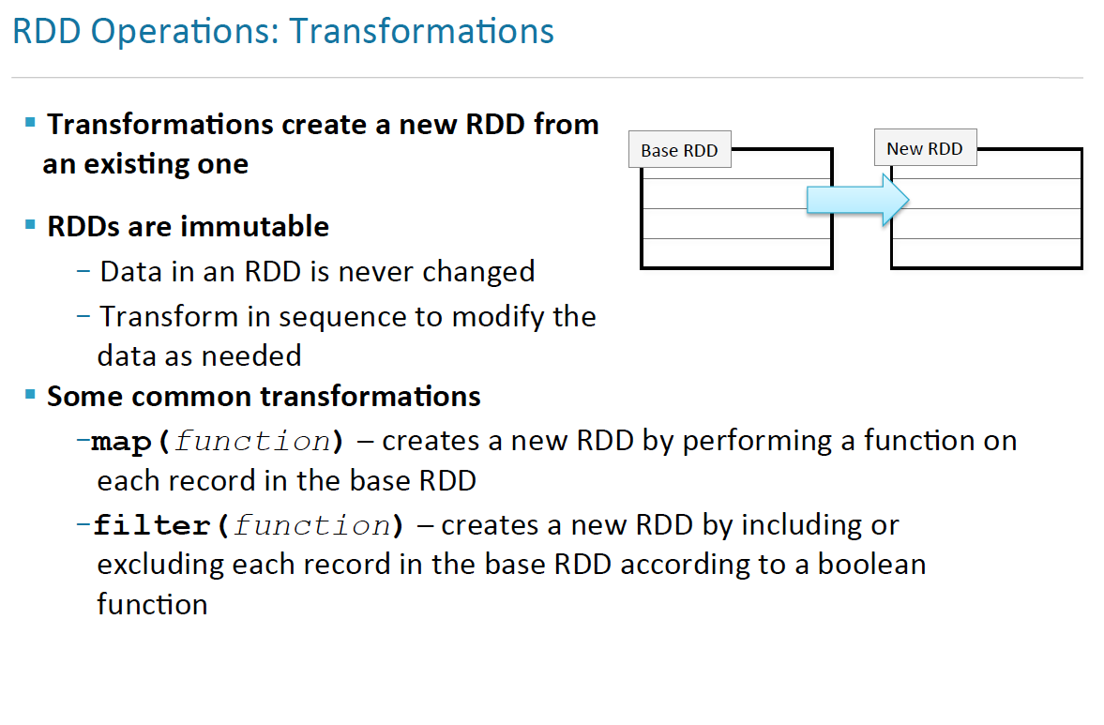
RDD Operations - Transformations
INCEPTEZ TECHNOLOGIES

Slide 12
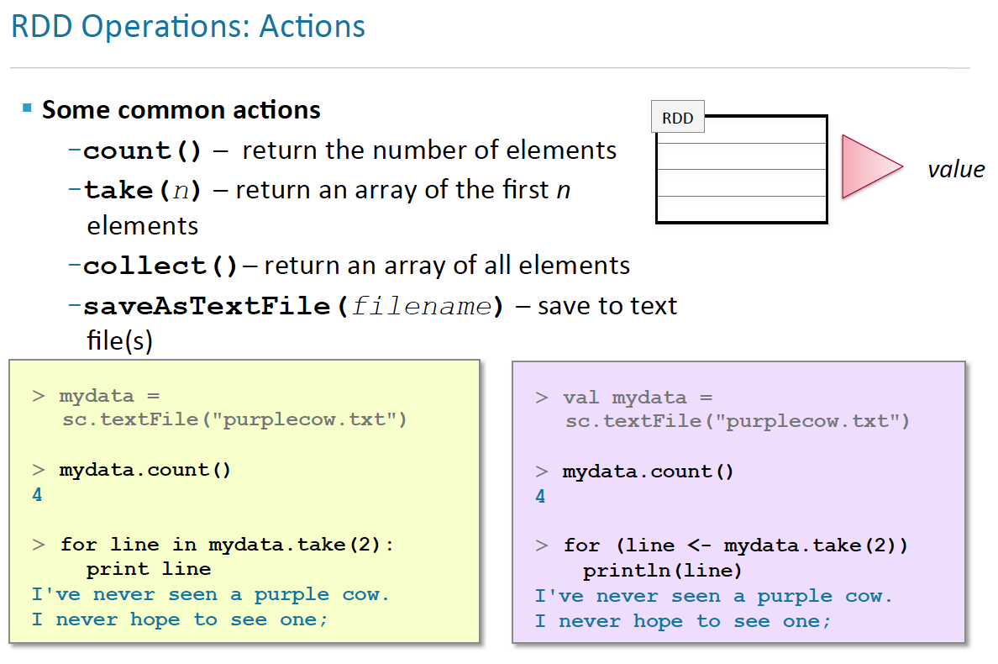
RDD Operations - Actions
INCEPTEZ TECHNOLOGIES

Slide 13

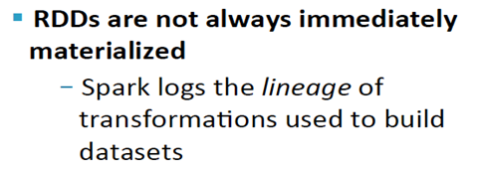
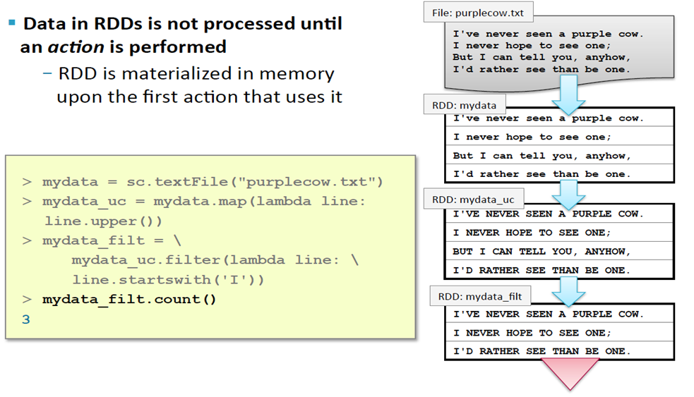
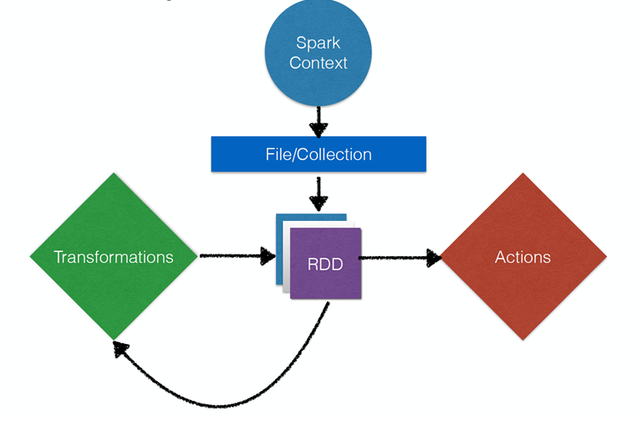
RDD Execution model (Lazy Evaluation)
RDD Execution model – Lazy Evaluation
Spark Context - Main entry point for Spark functionality,
Represents a connection to a Spark cluster
INCEPTEZ TECHNOLOGIES

Slide 14
RDD Execution Model
INCEPTEZ TECHNOLOGIES

Slide 15
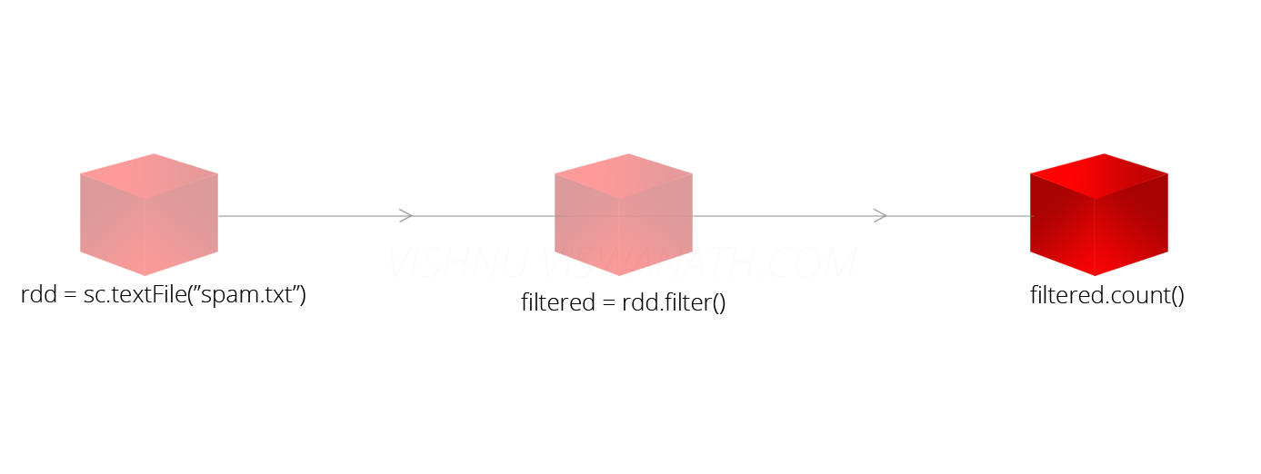
RDD Lineage
When you call a transformation, Spark does not execute it immediately, instead it creates a lineage.
A lineage keeps track of what all transformations has to be applied on that RDD, including from where it has to read the data.
Lineage
Lineage
val rdd = sc.textFile("spam.txt")
val filtered = rdd.filter(line => line.contains("money"))
filtered.count()
INCEPTEZ TECHNOLOGIES

Slide 16
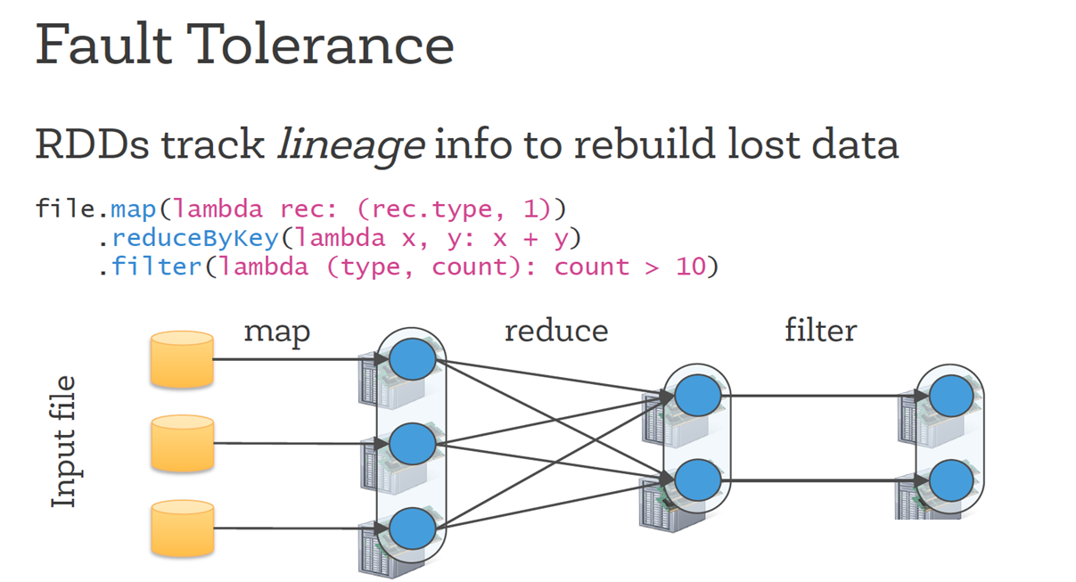
Fault Tolerance
INCEPTEZ TECHNOLOGIES

Slide 17
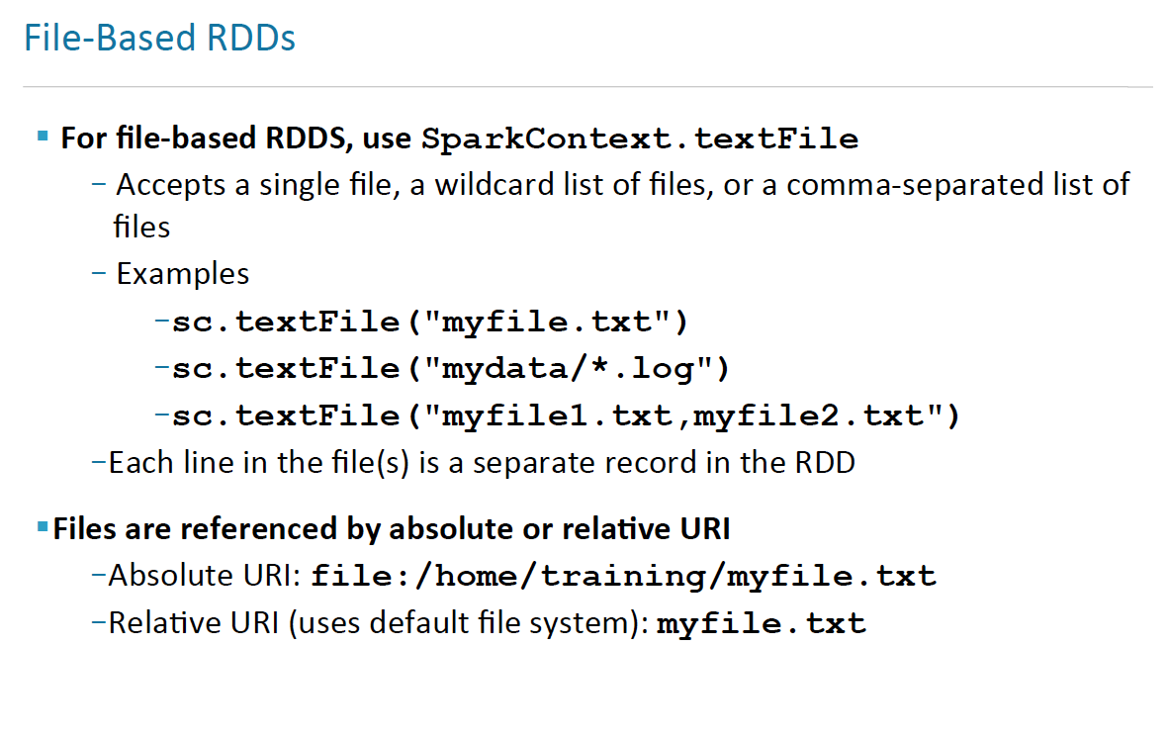
Loading data in RDD
INCEPTEZ TECHNOLOGIES

Slide 18
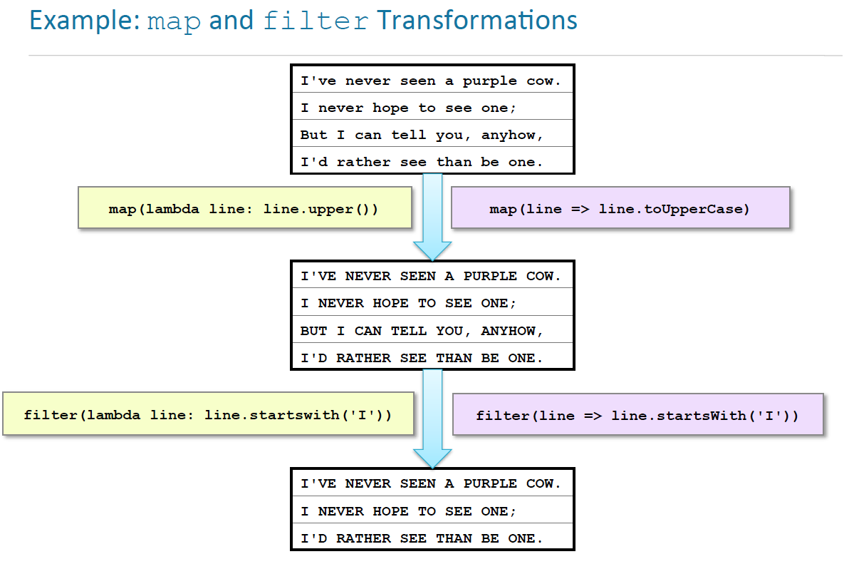
INCEPTEZ TECHNOLOGIES

Slide 19
RDD Operations
INCEPTEZ TECHNOLOGIES

Slide 20
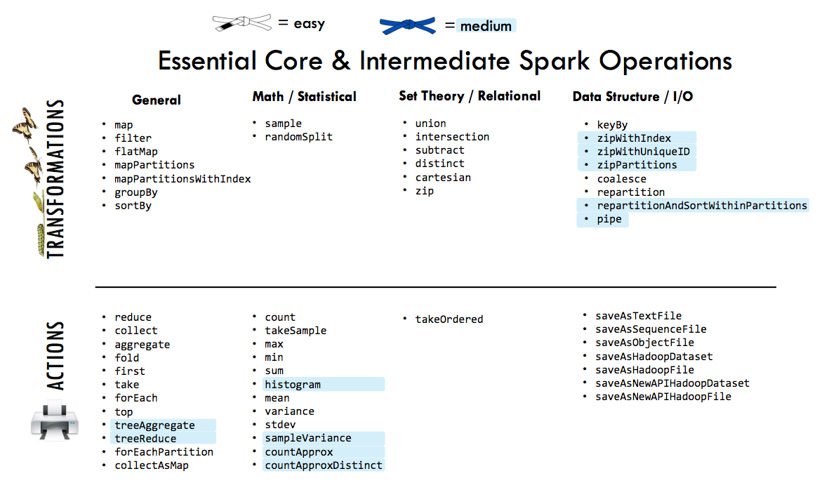
INCEPTEZ TECHNOLOGIES

Slide 21
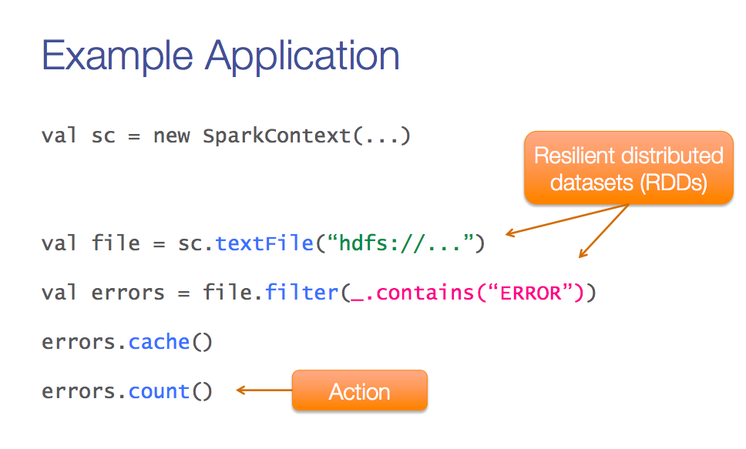
A Sample Application
SparkContext
Transformation
INCEPTEZ TECHNOLOGIES

Slide 22
Spark Parallelism
sc.parallelize = defaultParallelism
scala> sc.defaultParallelism
res: Int = 4
scala> sc.parallelize(1 to 100).partitions.size
defaultMinPartitions = min(defaultParallelism, 2)
scala> sc.defaultMinPartitions
res: Int = 2
dfs.block.size - (Default size in Hadoop 2.x 128MB).
In the local file system the corresponding parameter is
fs.local.block.size - (Default value 32MB).
def textFile(path: String, minPartitions: Int = defaultMinPartitions): RDD[String]
sc.textFile = max(defaultMinPartitions, no of Inputsplit)
INCEPTEZ TECHNOLOGIES

Slide 23
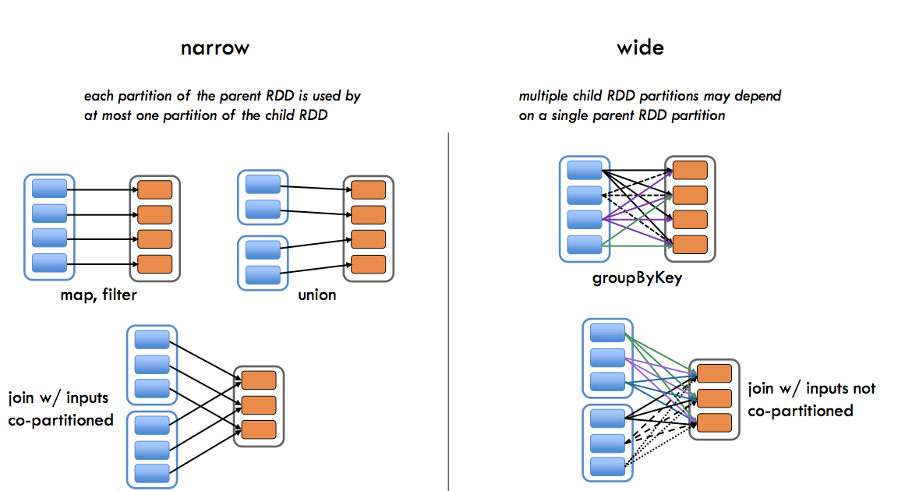
Types of Transformations
INCEPTEZ TECHNOLOGIES

Slide 24
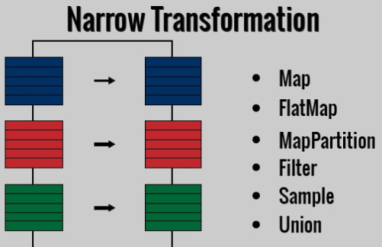
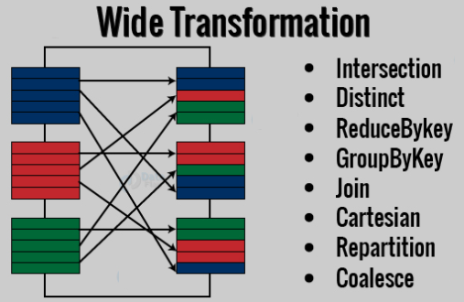
Types of Transformations
INCEPTEZ TECHNOLOGIES

Slide 25
Transformations
INCEPTEZ TECHNOLOGIES

Slide 26
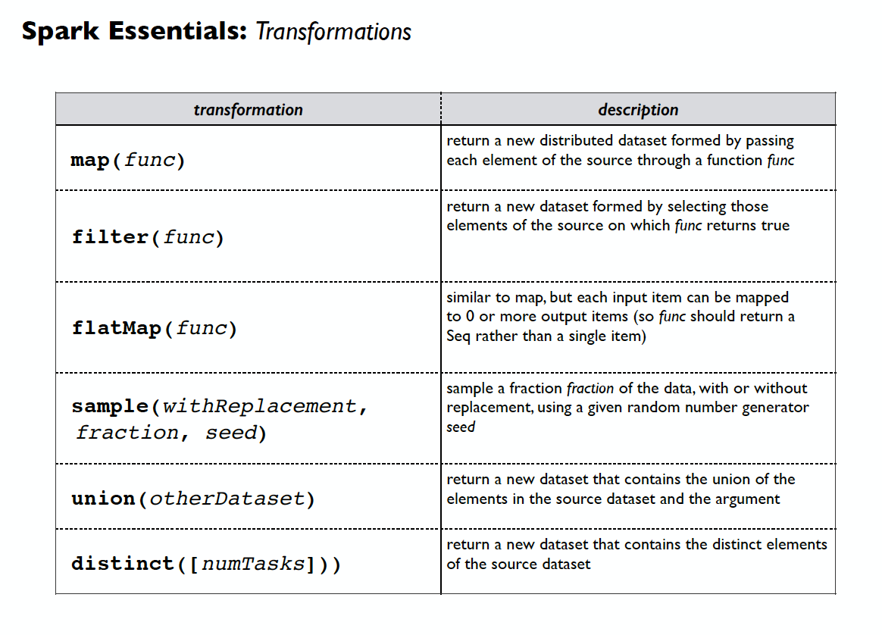
Spark Essentials : Transformations
INCEPTEZ TECHNOLOGIES

Slide 27
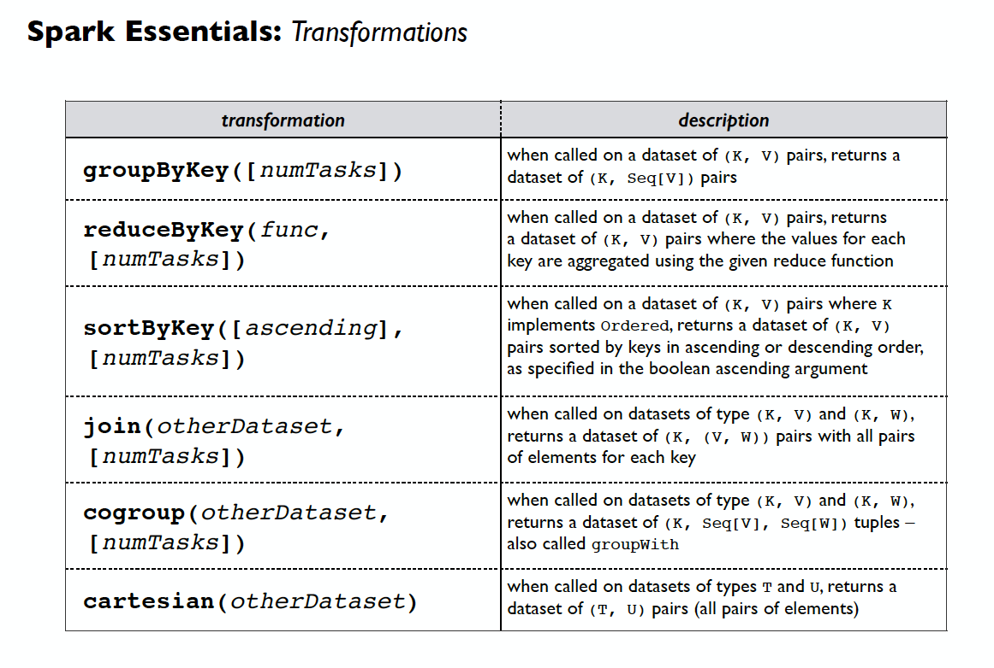
Spark Essentials : Transformations
INCEPTEZ TECHNOLOGIES

Slide 28
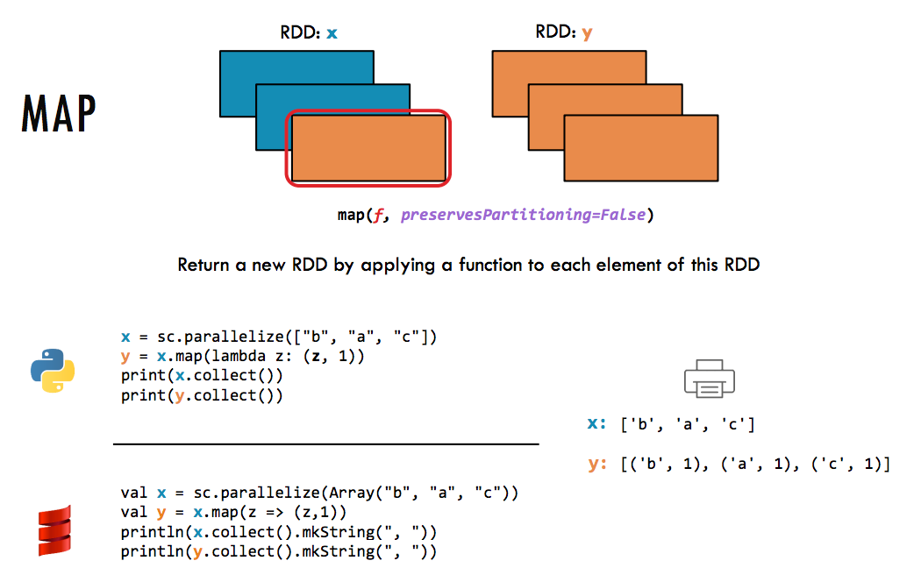
INCEPTEZ TECHNOLOGIES
INCEPTEZ TECHNOLOGIES

Slide 29
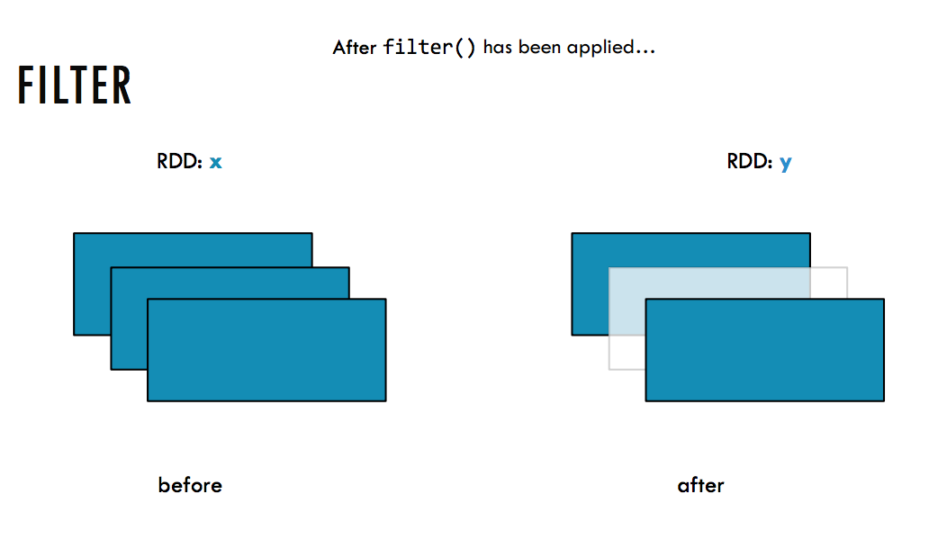
INCEPTEZ TECHNOLOGIES

Slide 30
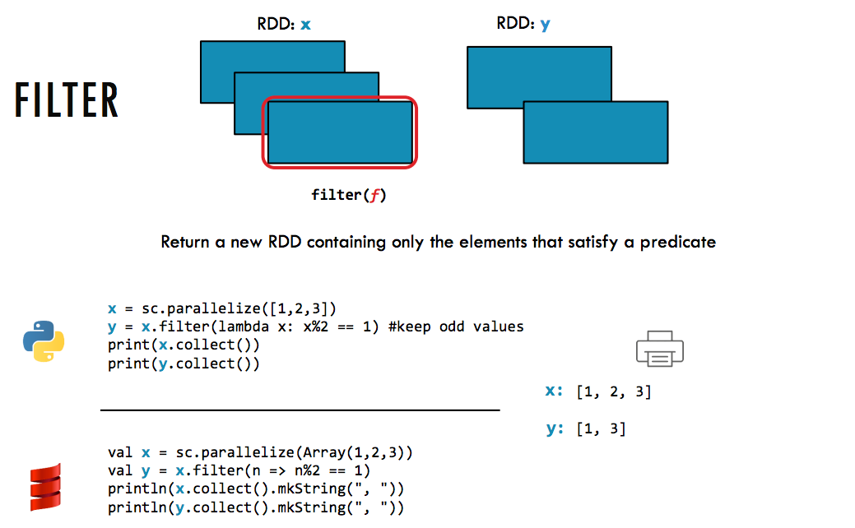
INCEPTEZ TECHNOLOGIES

Slide 31
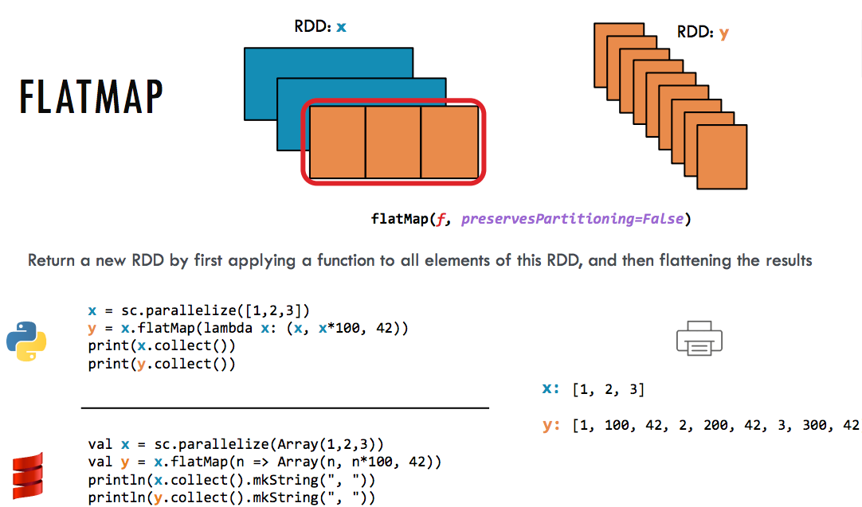
INCEPTEZ TECHNOLOGIES

Slide 32
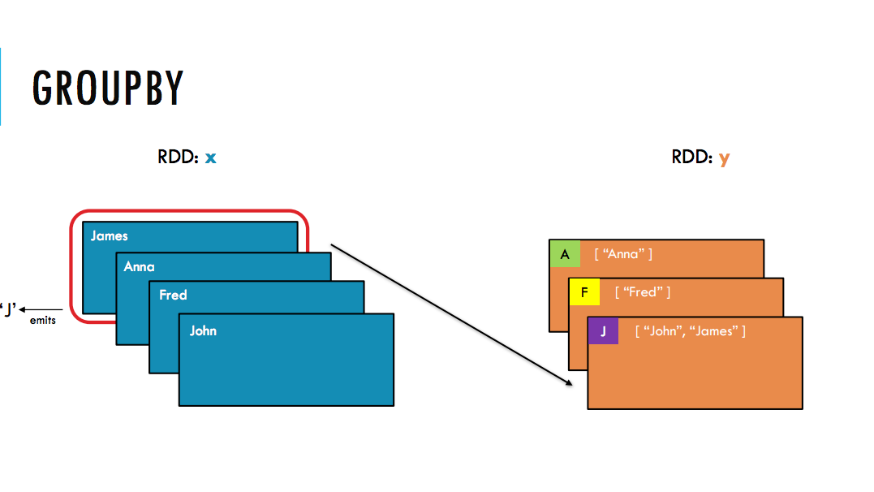
INCEPTEZ TECHNOLOGIES

Slide 33
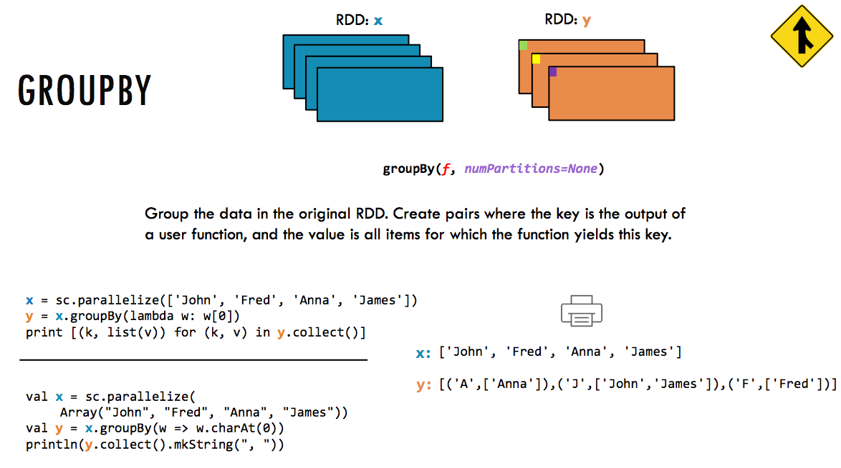
INCEPTEZ TECHNOLOGIES

Slide 34
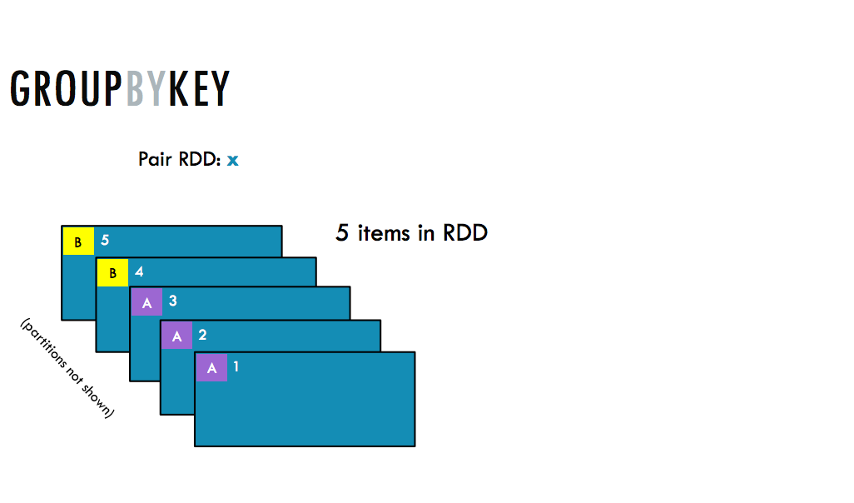
INCEPTEZ TECHNOLOGIES

Slide 35
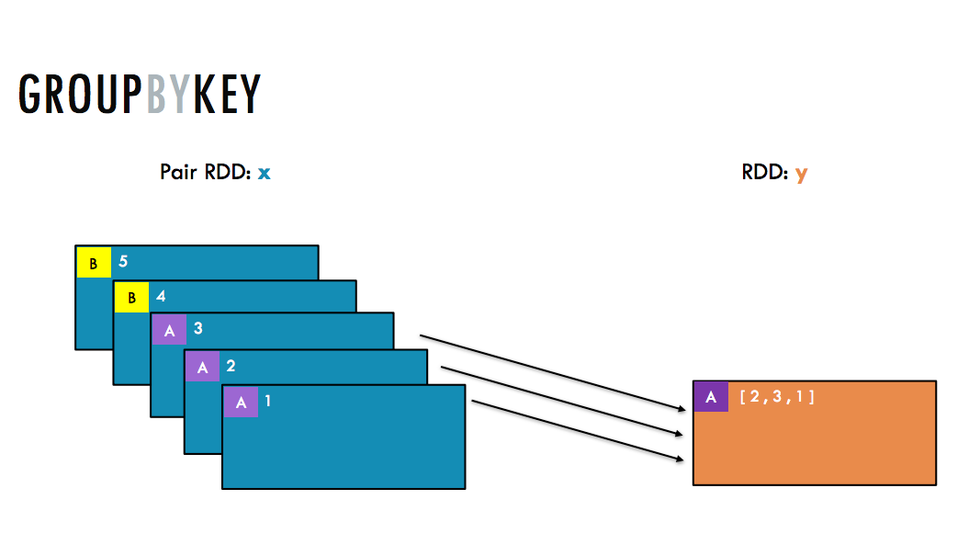
INCEPTEZ TECHNOLOGIES

Slide 36
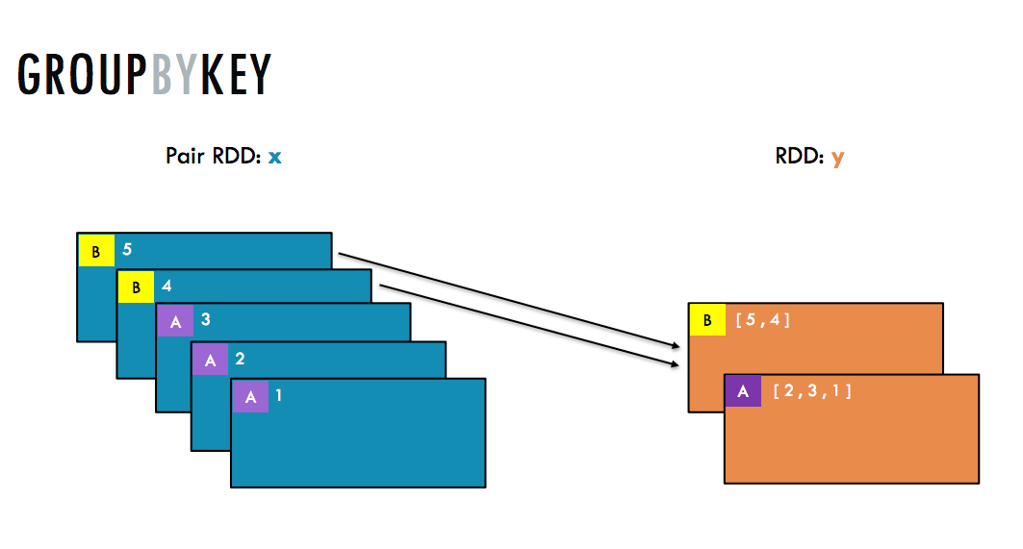
INCEPTEZ TECHNOLOGIES

Slide 37
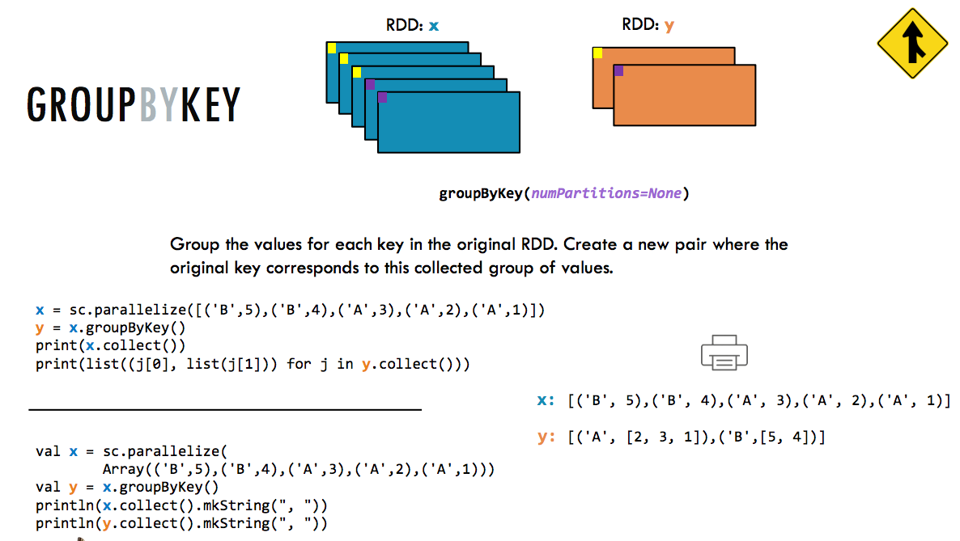
INCEPTEZ TECHNOLOGIES
INCEPTEZ TECHNOLOGIES

Slide 38
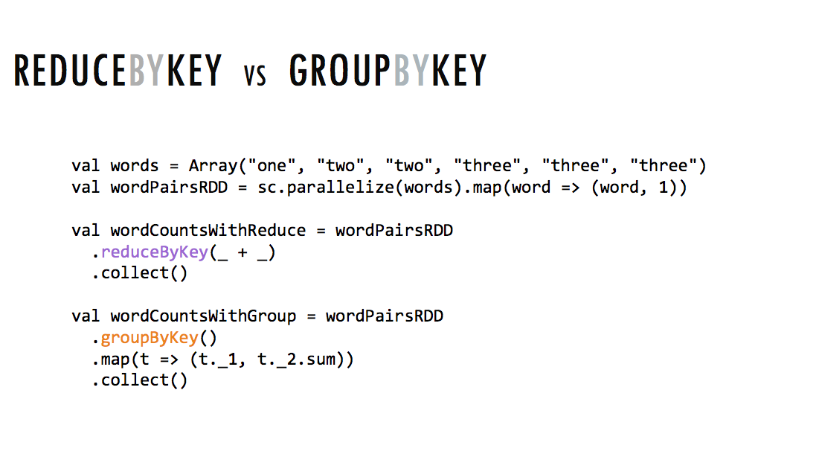

Slide 39
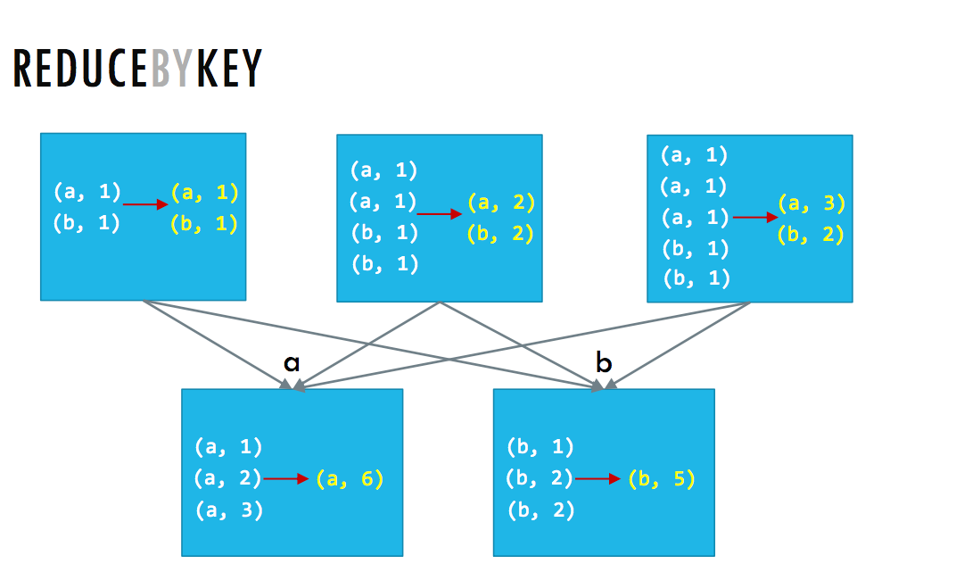
INCEPTEZ TECHNOLOGIES

Slide 40
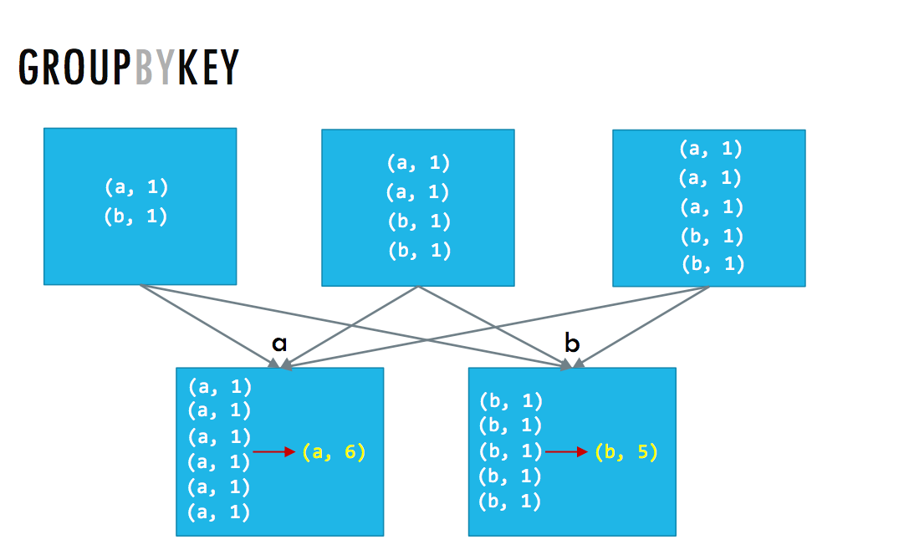
INCEPTEZ TECHNOLOGIES

Slide 41
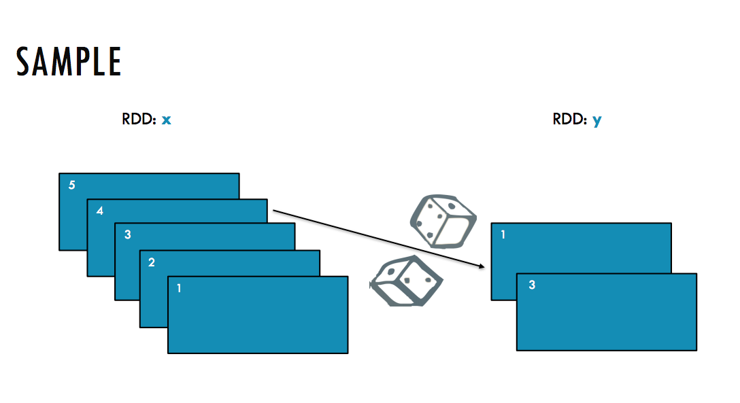

Slide 42
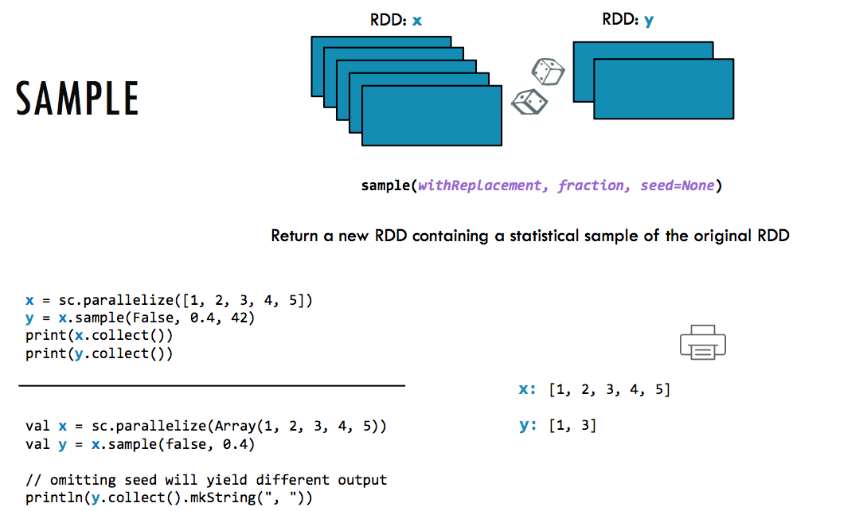
INCEPTEZ TECHNOLOGIES

Slide 43
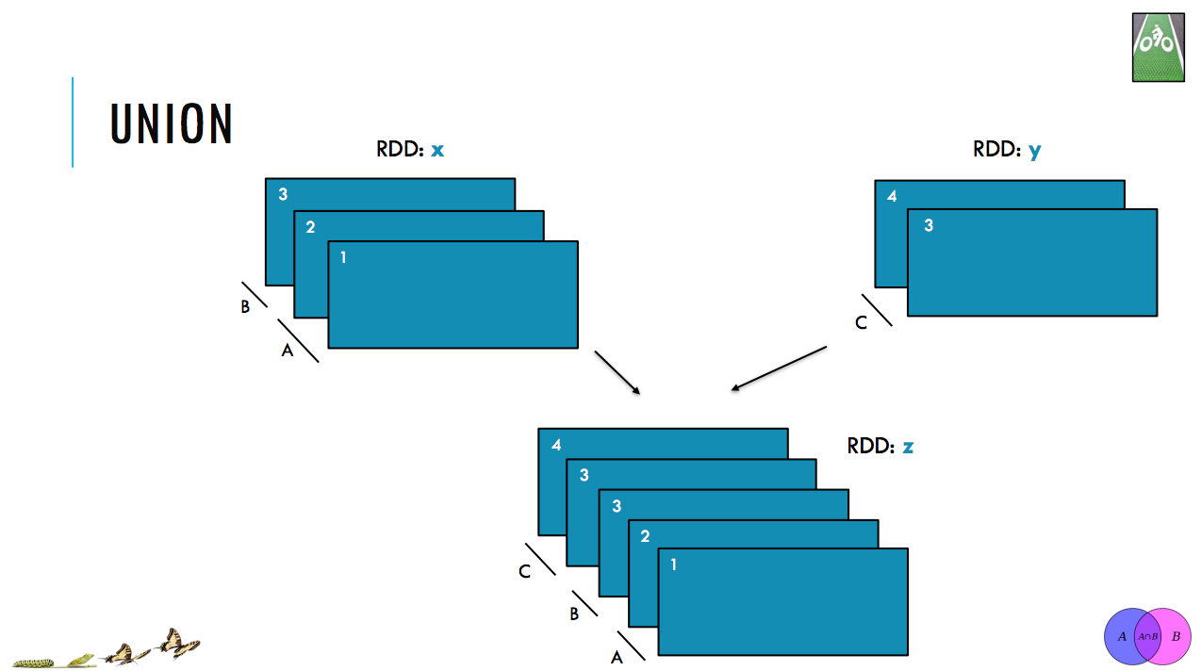
INCEPTEZ TECHNOLOGIES

Slide 44
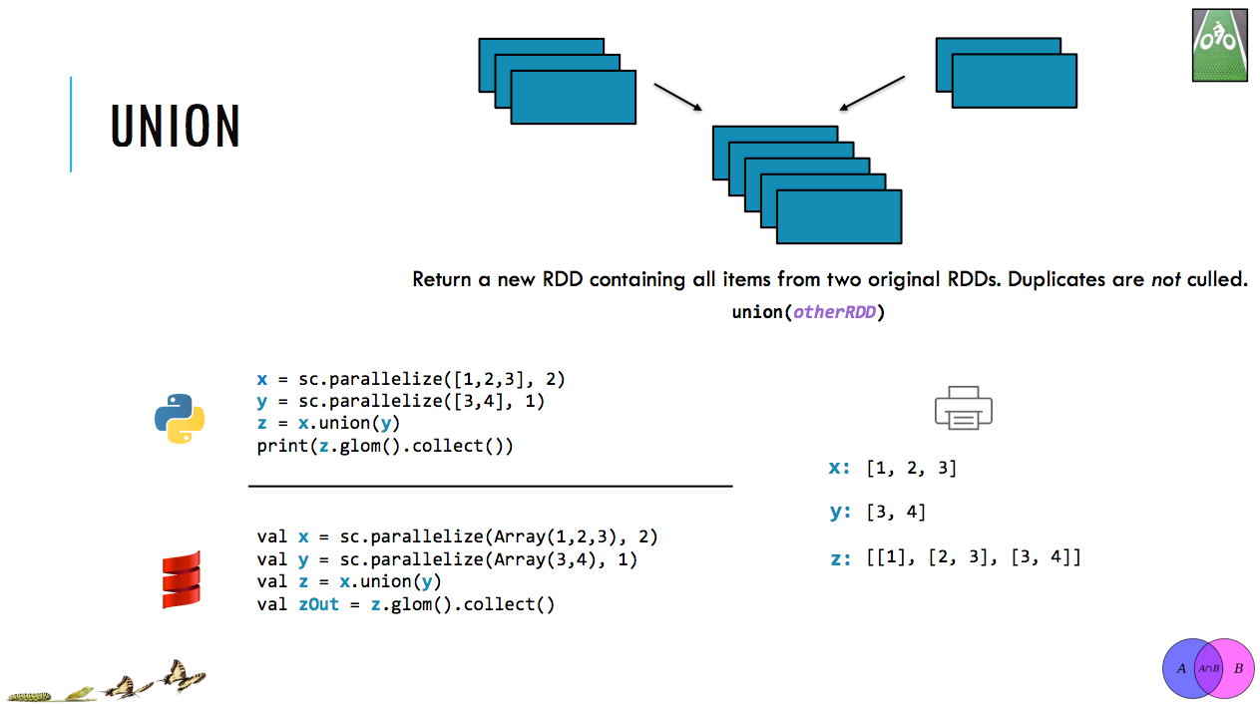
INCEPTEZ TECHNOLOGIES

Slide 45
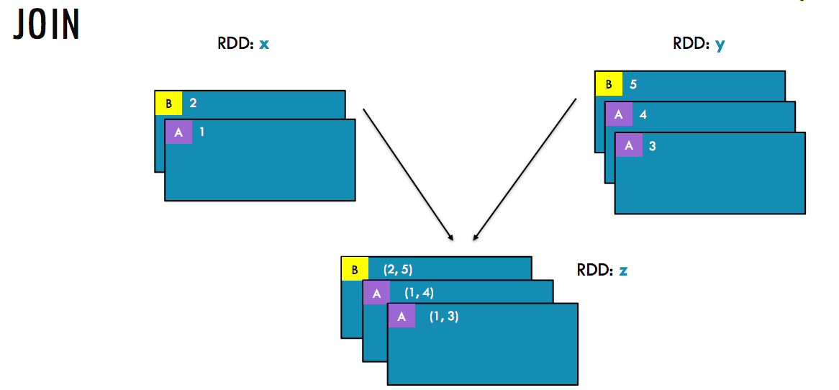
INCEPTEZ TECHNOLOGIES

Slide 46
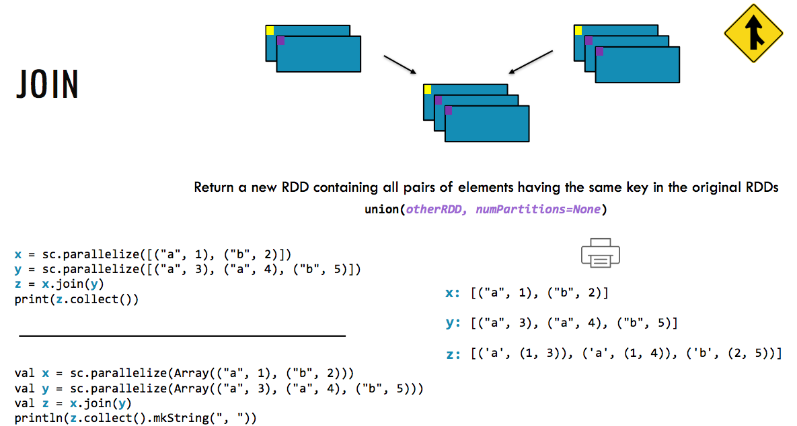
INCEPTEZ TECHNOLOGIES

Slide 47
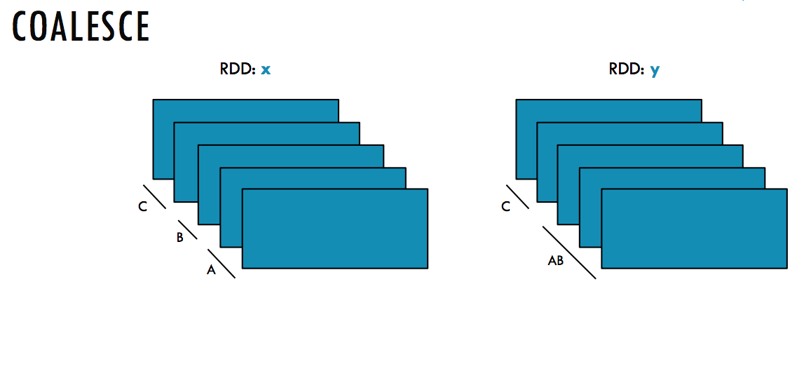
INCEPTEZ TECHNOLOGIES

Slide 48
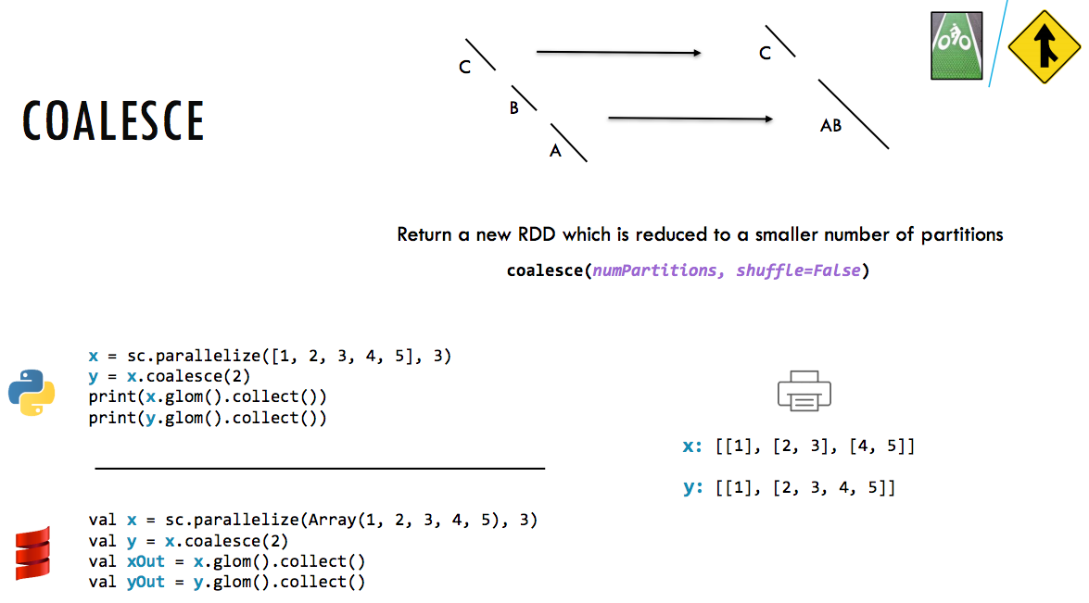
INCEPTEZ TECHNOLOGIES

Slide 49
Actions
INCEPTEZ TECHNOLOGIES

Slide 50
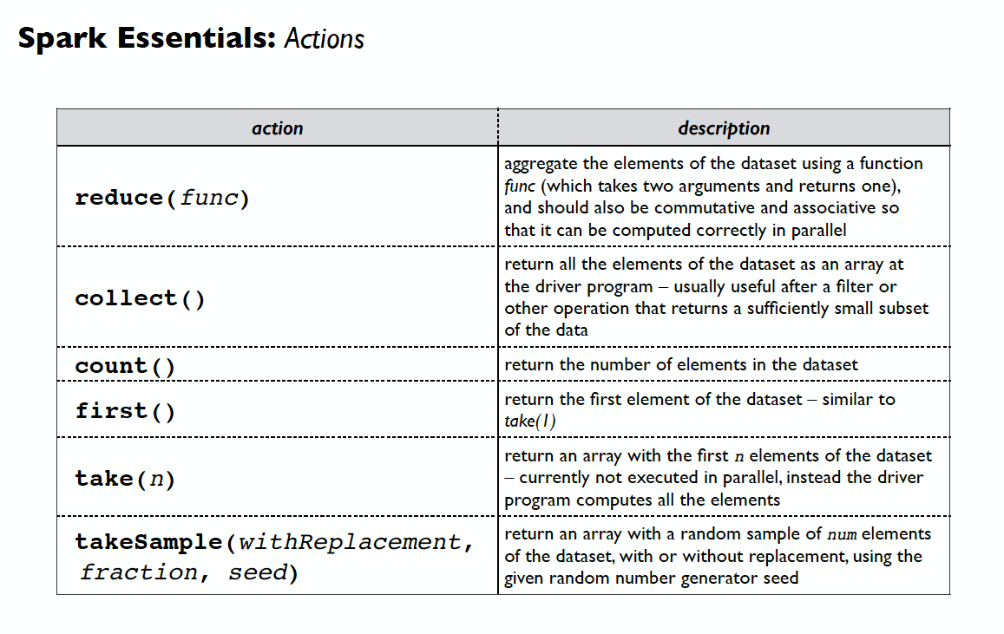
Actions
INCEPTEZ TECHNOLOGIES

Slide 51
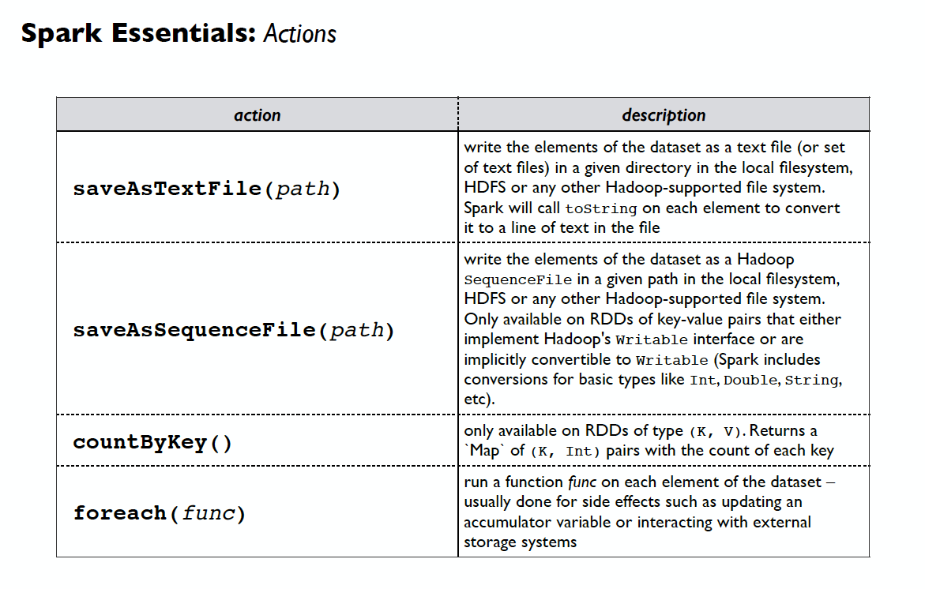
Actions
INCEPTEZ TECHNOLOGIES

Slide 52
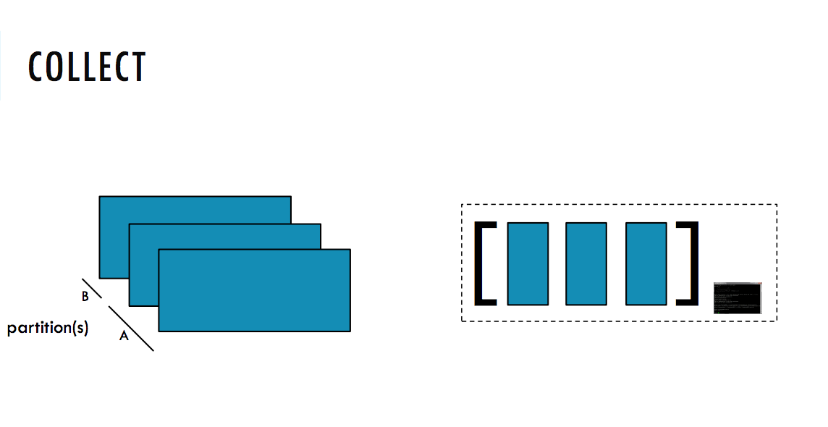
INCEPTEZ TECHNOLOGIES

Slide 53

INCEPTEZ TECHNOLOGIES

Slide 54

INCEPTEZ TECHNOLOGIES

Slide 55

INCEPTEZ TECHNOLOGIES

Slide 56

INCEPTEZ TECHNOLOGIES

Slide 57

INCEPTEZ TECHNOLOGIES

